Slide 1
ISI Space Antenna Results
Gabriel Burdan – 4/13/2026

Slide 2
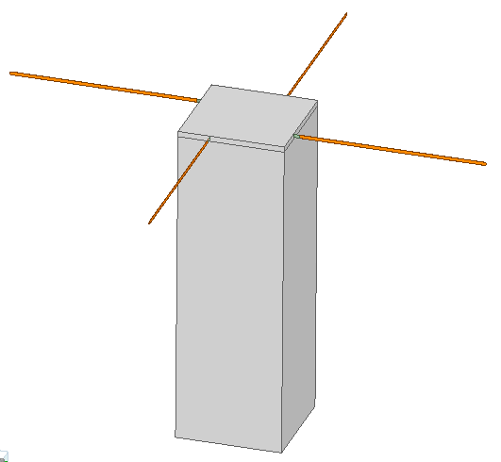
Quadrupole Turnstile Antenna
Current ISI Space Antenna configuration
Tuned to be impedance matched at 401 MHz
3U Structure underneath antenna
Fed with 4x lumped ports, each with a 90 degree phase offset

Slide 3
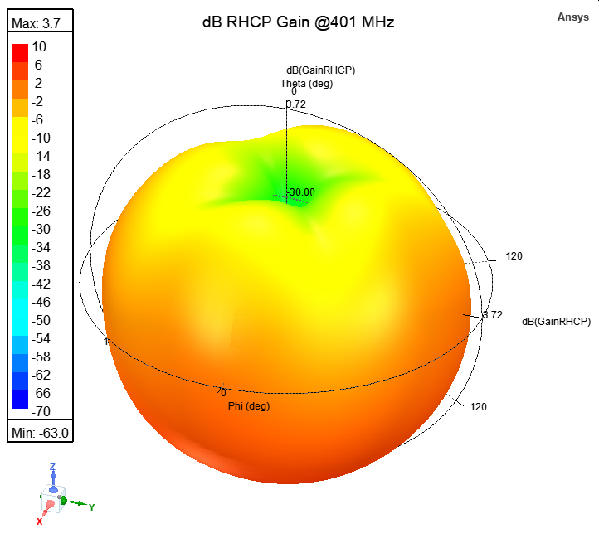
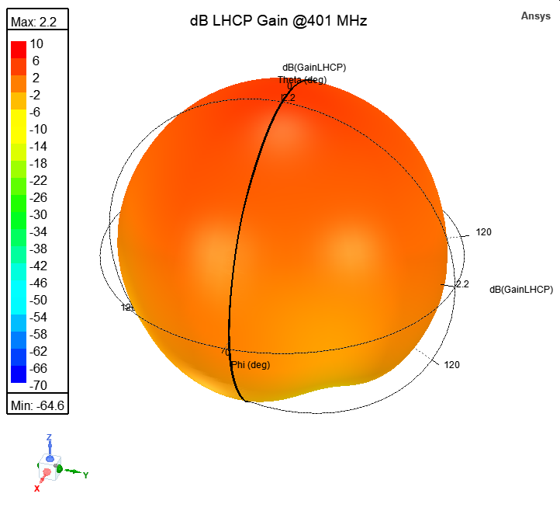
3D Gain Patterns

Slide 4
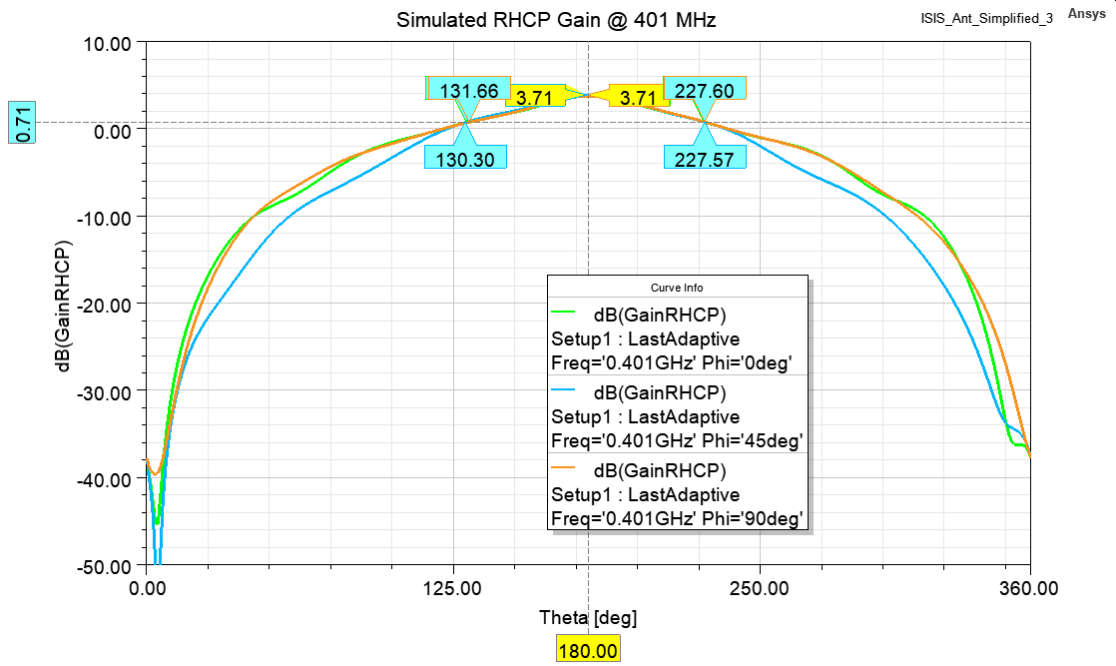

2D RHCP Gain Cuts @401 MHz
Good pattern symmetry within HPBW
Peak RHCP Gain = 3.71 dB
HPBW ~= 100 degrees
Main lobe orientation shown below

Slide 5
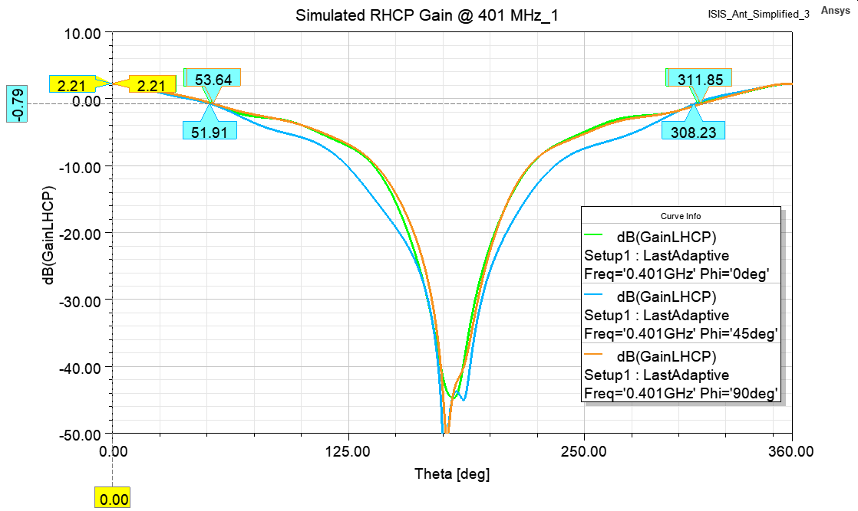

2D LHCP Gain Cuts @401 MHz
Good pattern symmetry within HPBW
Peak LHCP Gain = 2.21 dB
HPBW ~= 100 degrees
Main lobe orientation shown below

Slide 6
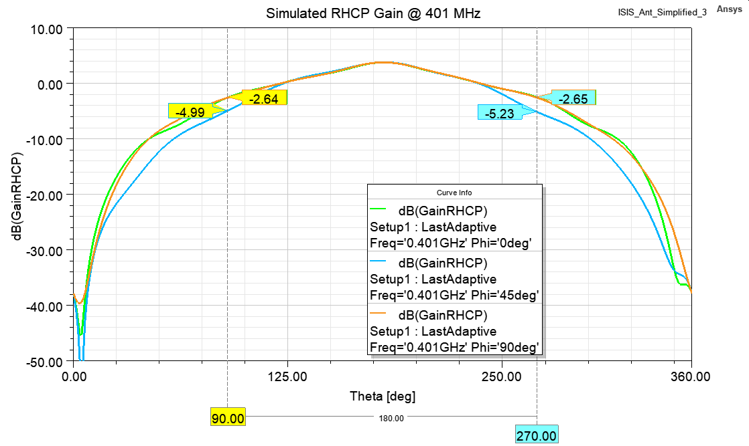
Off Axis RHCP Radiation Properties
Pattern symmetry degrades away from boresight
RHCP Radiation for +/- 90 degrees off boresight shown
AR shown on next slide

Slide 7
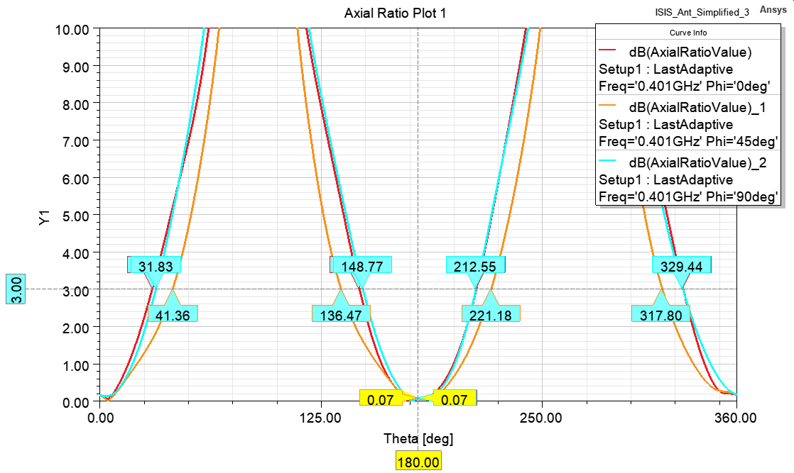
Axial Ratio @401 MHz
Main beams (RHCP and LHCP) have low AR
RHCP circularly polarized beamwidth ~= 64 degrees
LHCP circularly polarized beamwidth ~= 62 degrees
Off-axis EM waves linearly polarized

Slide 8
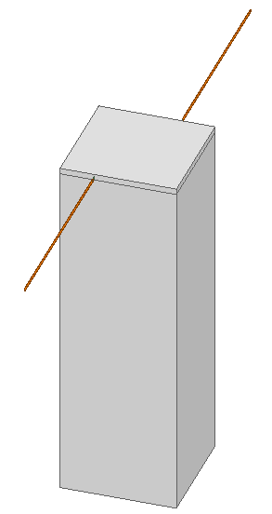
Dipole Turnstile Antenna
Proposed ISI Space Antenna configuration
Tuned to be impedance matched at 401 MHz
3U Structure underneath antenna
Fed with 2x lumped ports, each with a 180 degree phase offset

Slide 9
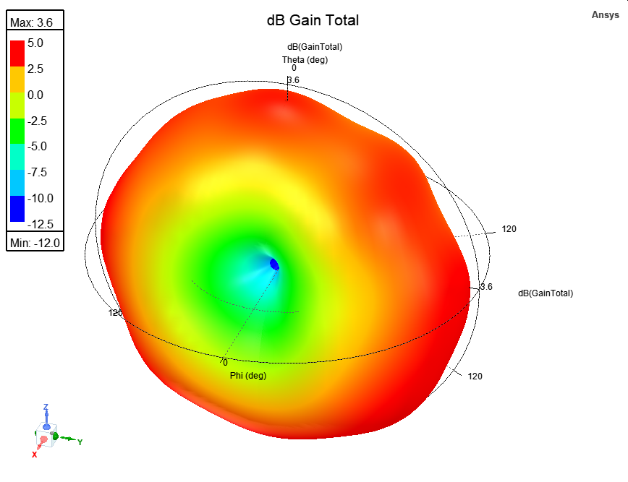
3D Gain Pattern

Slide 10
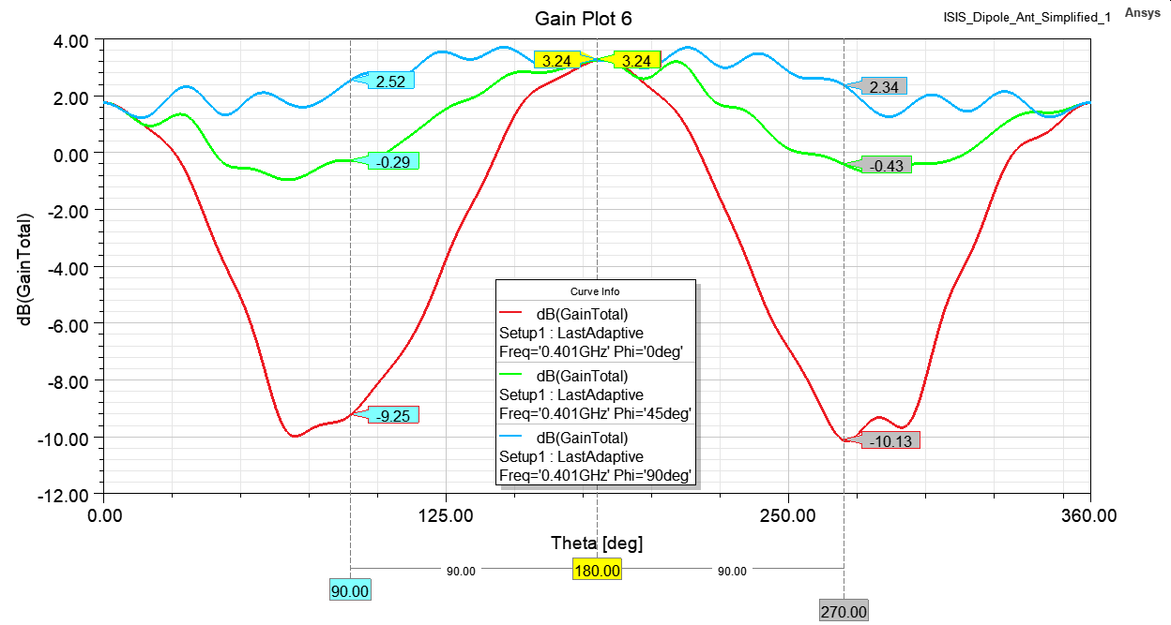
2D Radiation Pattern
Linearly polarized omnidirectional pattern
Nulls at dipole ends (phi = 90 deg, theta ~= 90, 270 deg)
Peak gain = 3.63 dB

Slide 11
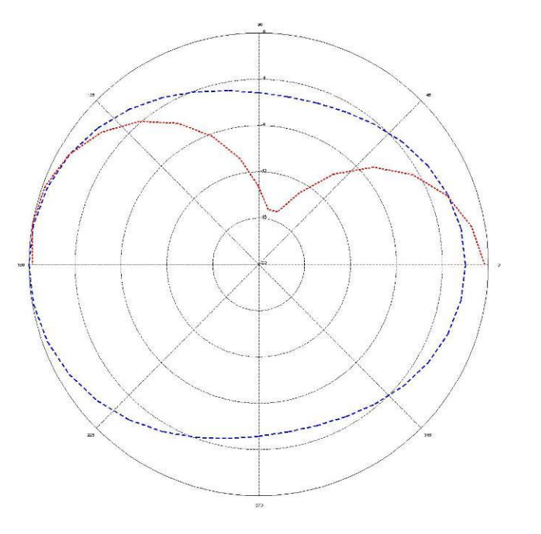
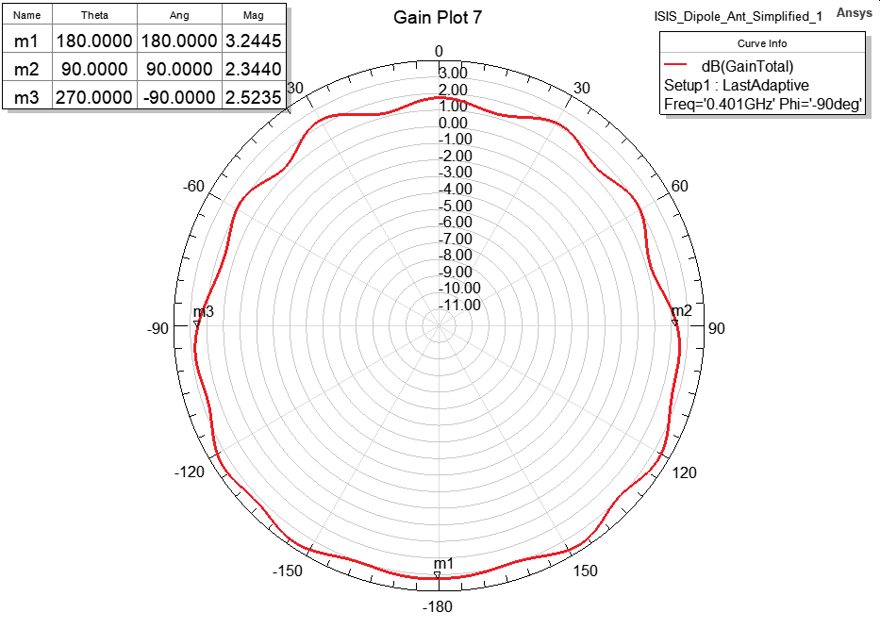
Comparison to ISI Space Antenna Manual
Omnidirectional pattern for both models
Peak gain aligned with CubeSat in both cases
Nulls at dipole ends (more on next slide)
Total dB Gain vs Theta @ Phi = 90
@ 401 MHz with 3U CubeSat Underneath
Total dB Gain vs Theta @ Phi = 0 (blue dotted line) for a UHF Antenna with 2U CubeSat Underneath
*Red arrows indicate direction CubeSat structure is pointing for each simulation

Slide 12
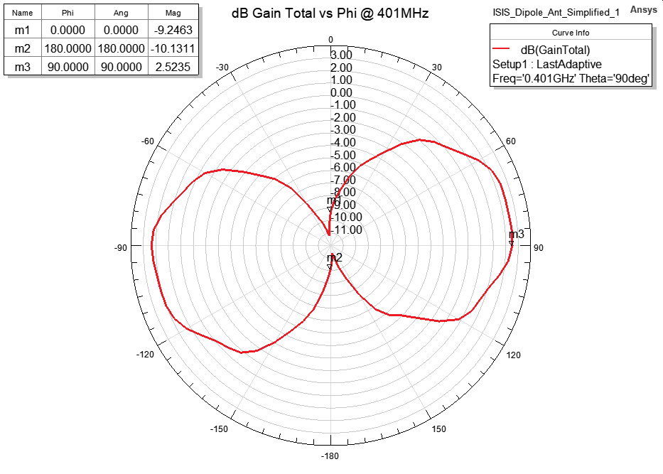
Comparison to ISI Space Antenna Manual
Similar pattern asymmetry
Different coordinate axis definitions, but null observed in both patterns
Total dB Gain vs Phi @ Theta = 90
@ 401 MHz with 3U CubeSat Underneath
Total dB Gain vs Phi @ Theta = 0 (solid red line) for a UHF Antenna with 2U CubeSat Underneath

Slide 13
Next Steps
Model reflected power into antenna feeds inside TVAC chamber
Minimize reflected power using optimization

